Slide 1
Smart Student Hub
TEAM NO : 10
NAME : A.Avinash (111723043048)
Tamanna Singh (111723043017)
Swati Sharma(111723043016)
Guide : Ms.O.Sirisha
Department: B.Sc Computer Science and Cloud Computing

Slide 2
Abstract
India’s higher education system is gradually adopting digital technologies, but many student achievements are still stored in paper documents or scattered files. This makes it difficult for students to manage and present their accomplishments effectively. It also increases the workload for teachers and institutions during verification and documentation. Smart Student Hub is designed to solve this problem by providing a centralized digital platform to store and manage academic and co-curricular records. Students can upload their achievements, while faculty members verify them to ensure authenticity. The system automatically generates a digital portfolio for each student. Recruiters can also access verified student profiles to evaluate candidates efficiently. Overall, Smart Student Hub helps save time, reduce administrative work, and improve student visibility in the digital education ecosystem.

Slide 3
INTRODUCTION
Smart Student Hub is a digital platform designed to help students manage their academic and co-curricular achievements in one place. In many institutions, student records are still stored in paper documents or scattered files, which makes management and verification difficult. This project provides a centralized system where students can upload certificates, achievements, and important records. Faculty members can verify these submissions to ensure authenticity and accuracy. The system automatically organizes the information and creates a digital portfolio for each student. It reduces manual work for teachers and institutions by simplifying documentation and record management. Recruiters can easily view verified student profiles and evaluate candidates more efficiently. Overall, Smart Student Hub improves transparency, saves time, and supports the digital transformation of the education system.

Slide 4
System Requirements
Hardware Requirements:
Software Requirements:
Frontend: React, Next.js, Tailwind CSS
Backend: Node.js + Express
Database: PostgreSQL
CLOUD :
Devices – Desktops, laptops, mobiles, tablets
Processor – Dual-core or higher systems
Network – Stable internet connection
Storage – No minimum storage required
(data stored in cloud)

Slide 5
Existing system:
DigiLocker / NAD: Stores academic certificates, but doesn’t handle co-curricular records or full student portfolios.
Academic Bank of Credits (ABC): Tracks academic credits, but not achievements, skills, or verified profiles.
College ERP systems: Manage attendance/marks, but are not unified, secure, or portfolio-based.
Blockchain credential prototypes: Exist in research, but not widely used or complete for student profiling.

Slide 6
Proposed System:
Smart Student Hub offers a single digital platform where students can upload and store all their academic and co-curricular achievements. Teachers can easily verify these records, and the system automatically generates a complete digital portfolio for each student. Institutions can quickly prepare NAAC/NIRF reports using organised data, and recruiters can access verified student profiles. This creates a simple, secure, and efficient way to manage student achievements.
System Flow:
Student uploads + faculty input + institutional data +
faculty verification + Dashboards , portfolios and reports.

Slide 7
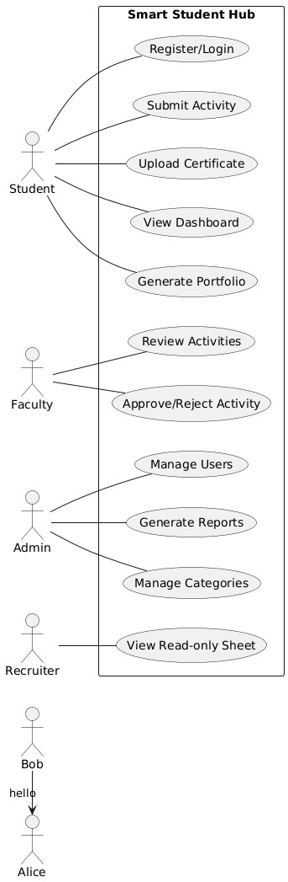
Use case:

Slide 8
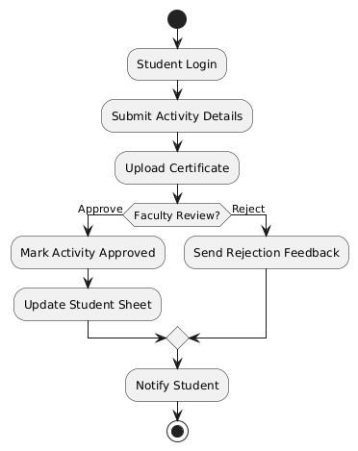
Activity diagram:

Slide 9
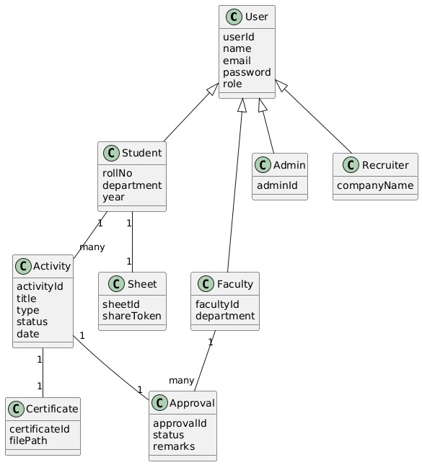
Class diagram:

Slide 10
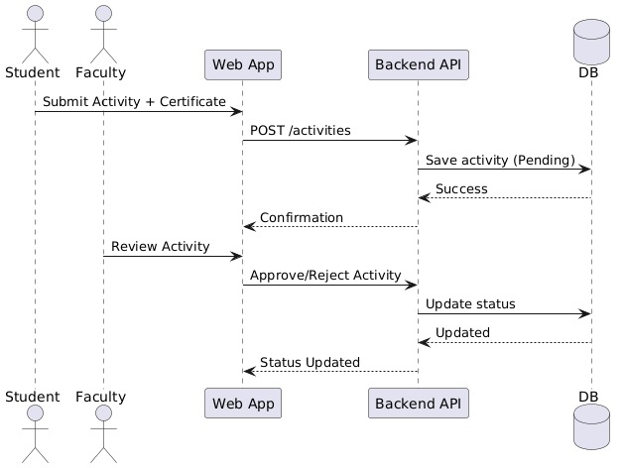
Sequence diagram:

Slide 11
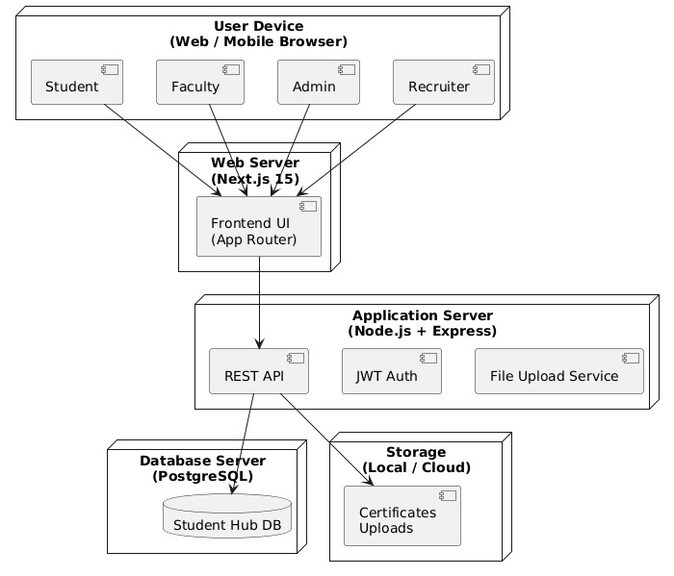
Deploying diagram:

Slide 12
FUTURE SCOPE
The Smart Student Hub is scalable and can be extended with advanced features:
Mobile Application (Android & iOS) for on-the-go access
AI-based Analytics for skill gap analysis and career recommendations
Integration with LMS & ERP Systems (Moodle, Canvas, SAP, etc.)
Advanced Accreditation Reports for NAAC, NIRF, AICTE
Blockchain-based Certificate Verification
Multi-institution & University-level Deployment
Predictive Insights for placements and academic performance
Alumni Access & Lifelong Portfolio Support

Slide 13
Bibliography / References (Post-2020)
Ministry of Education, Government of India. National Education Policy (NEP) 2020., 2020.
National Assessment and Accreditation Council (NAAC). Revised Accreditation Framework
& Metrics., 2021.
All India Council for Technical Education (AICTE). Model Curriculum & Digital Education Initiatives., 2022.
ISO/IEC 25010. Systems and Software Quality Models., 2023.
Sommerville, I. Software Engineering (10th Edition). Pearson Education, 2021.
PostgreSQL Global Development Group. PostgreSQL Official Documentation., 2023.

Slide 14
THANK YOU

